Slide 1
IAM: Digital Oil Field Application in Anadarko’s DJ Basin
September 6th, 2018

Slide 2
Agenda
Introduction
  Who we are
  What we do
  What is Digital Oil Field (DOF)?
Business Impact
  Horizontal Well/Facility Surveillance
  Drawdown Test Management
  Well Modelling/ Automated Well Based Forecasting
  Midstream Management
Future Plans
  Closed Loop Automation: Intelligent Control

Slide 3
Introduction

Slide 4
Who are we?
DJ Basin Integrated Asset Management Team
Obi Ogueri IAM Supervisor
Kreg Flowers Prod. Engr.
Jay Odom Staff Prod. Engr.
Robert Palumbo: Sr. ITS Developer
Damiano Galvan Staff Reservoir Engr.
Staff Prod. Engr.
Drawdown Mgmt.
Subsurface Modelling
Automated Forecasting
Model Management
Midstream & IOC Integration
Exception Based workflows
Software Development
Data Model Maintenance
Special Studies
  Saltwater Disposal Modeling
  Reservoir Modelling
  PVT Data and Modeling
  SRV Estimation and Monitoring
Closed Loop Automation Project
IoT Projects
Exception Based Surveillance

Slide 5
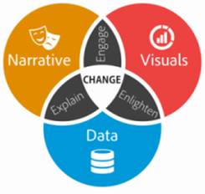
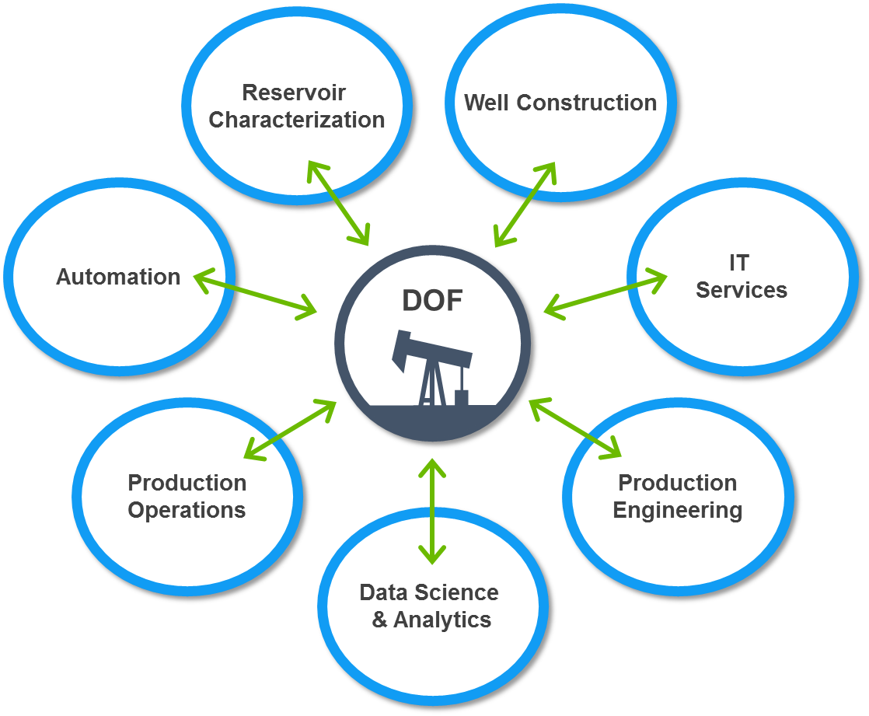
What we do?
DJ Basin Integrated Asset Management Team
Mission Statement:
  Develop robust and sustainable solutions to enable multiple functions in the efficient management of APC’s DJ assets by:
    Turning Data into Knowledge: through improved understanding of system performance
    Expediting decision making: through the implementation of effective tools for well surveillance and production optimization
    Increasing communication between multidisciplinary teams: Production, Operations, Completions, Reservoir, Finance, AAET
How:
  Designing and Implementing Digital Oil Field (DOF) technologies in the DJ Basin
Notes:
DOF integration within the DJ Basin
Multiple functions impacted by DOF system
DOF success requires buy-in and trust from data suppliers and users
Collaboration enables transparent information sharing
DOF system “raises the bar” for skill development across company and ensures DOF development progresses

Slide 6
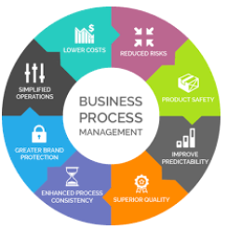


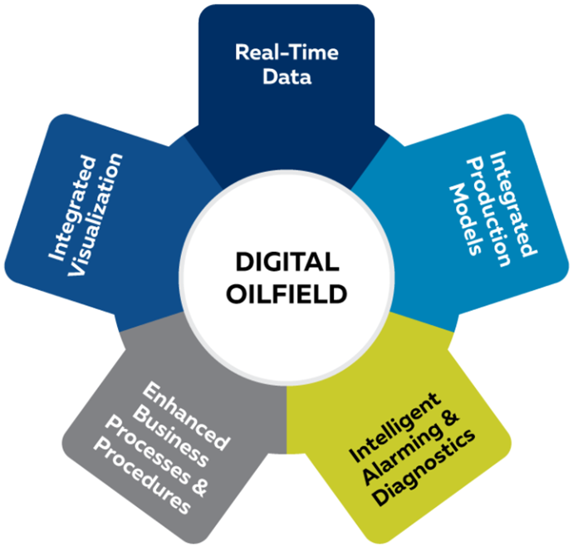
What is Digital Oil Field (DOF)?
  Integrated workflows
  Why?
Eliminate non-productive time
Maximize field recovery
Increase profitability
Business Process Management
Advanced Information Technology
Engineering Expertise
Notes:
The purpose of the digital oilfield is to maximize oilfield recovery, eliminate non-productive time, and increase profitability through the design and deployment of integrated workflows. Digital oilfield workflows combine business process management with advanced information technology and engineering expertise to streamline and, in many cases, automate the execution of tasks performed by cross-functional teams.
Business Process Management:
Operations (Safety, integrity monitoring, flow assurance)
Forecasting / Business Planning
Peer reviews / decision making
Optimization

Slide 7
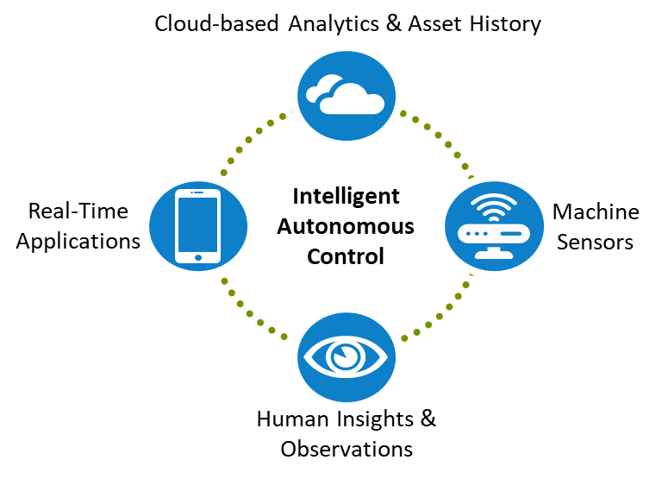
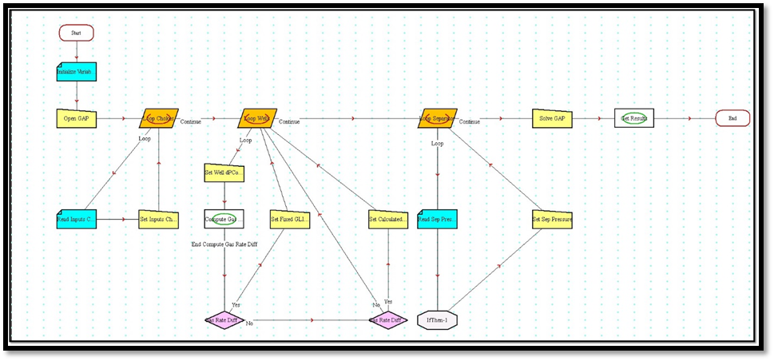
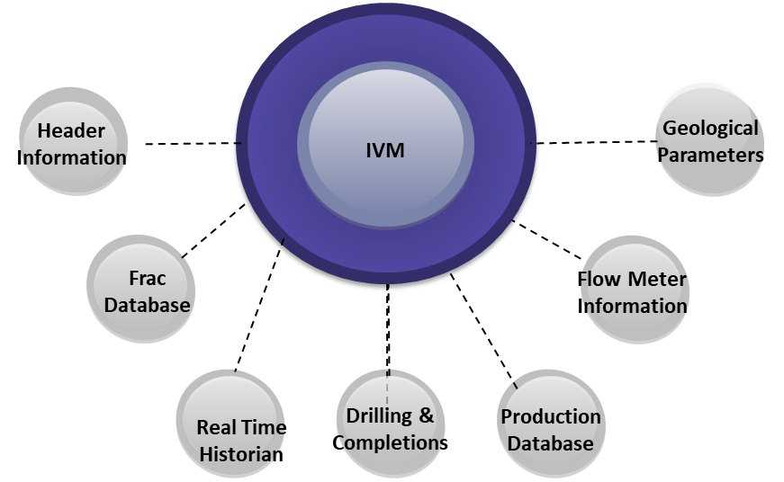
The IAM Journey…
Data Mgmt.:
Connecting to data sources
Gathering the data
Data Driven Exceptions:
Leveraging the data
Closed Loop Control: Intelligent Operations
Problem: Formulating a solution
2017 / 2018
2018 / 2019
2016 / 2017
2014 / 2015
Notes:
Identifying the problem and formulating a solution
Engineering problem formulation: Formulating the solution process

Slide 8
Anadarko IAM Work Spectrum
Data Driven Exceptions
Business Processes
Special Studies
Well Modeling
Drawdown Strategy
Completion Design
Production Forecasting
Separator Sizing
Artificial Lift Strategy
Prod Optimization
GOR Forecasting
RVP Prediction
Flow Assurance
Plunger Surveillance
Coriolis Monitoring
Well Loading Trends
Production Tracker
Line Pressure Surveillance
Dispatching
Income Statements
Pigging (Midstream)
Reporting
Employee Tracking
PETROLEUM ENGR.
SKILLS NEEDED
DATA ENGR.
LONG TERM
IMPACT
SHORT TERM
MORE
REVENUE
LESS
Notes:
Leveraging DOF capabilities across this spectrum
Monitoring over 1500 wells
~70 million new data points stored daily
Guides field staff to highest value opportunities by exception
Enhances production optimization practices

Slide 9
How are we impacting the business today?

Slide 10
Horizontal Well/Facility Surveillance
Jay

Slide 11
Drawdown Test Management
Kreg

Slide 12
Automated Well Based Forecasting
Kreg

Slide 13
Midstream Management
Jay

Slide 14
Future plans

Slide 15
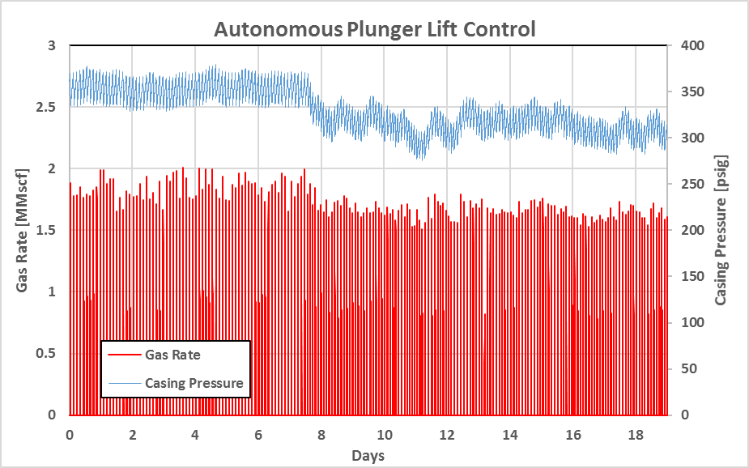


Intelligent Control
Leveraging advanced technologies
Edge computing
Internet of Things (IoT)
Reducing HSE footprint
Less field visits
Reduced vehicular traffic
Reduced operator exposure to live well operations
Increasing production rate
Sustained production uplift via optimal well control schedule
Elevated optimal frequency of intervention not attainable by operators
Cloud-based Analytics & Asset History
Intelligent
Autonomous
Control
Real-Time Applications
Machine Sensors
Manual control
Closed loop control
Human Insights & Observations
Autonomous control on DJ well shows improved drawdown management
Notes:
Going from Manual to automated control increases by an order of magnitude number of feasible well operation changes
Lift optimization is a non-linear problem, requires high frequency data, benefits from close-loop control.
Clear impact on recovery efficiency ➔ pressure decreasing faster due to higher depletion rate while maintaining stable lift
The Value of Intelligent Autonomous Control:
Autonomous continual optimization: sustained production uplift
Reservoir management: drawdown optimization
LOE: stable and consistent ops & downtime reduction
Efficiency: do more with less , every well matters

Slide 16
Back up

Slide 17
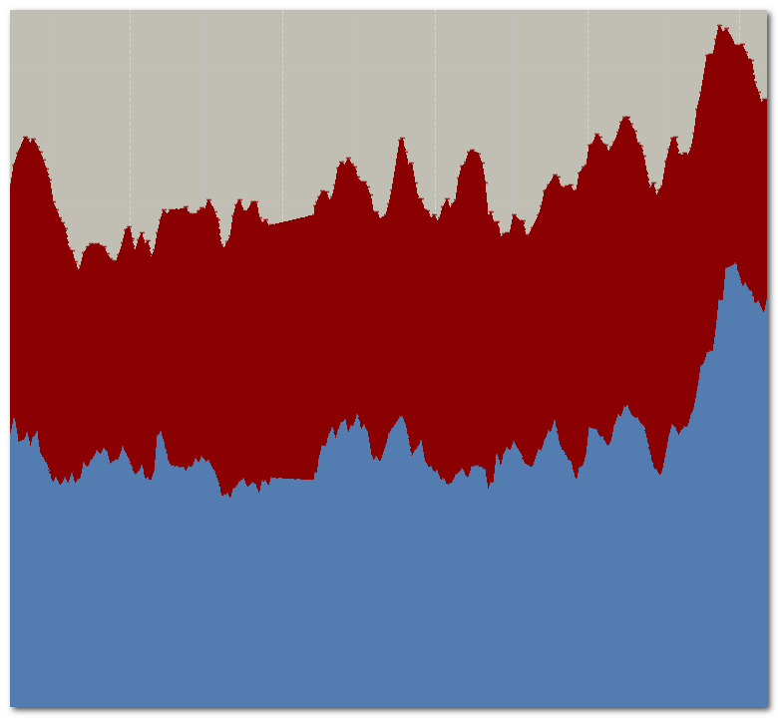
Anadarko DJ Basin DOF Overview
Monitoring over 1500 wells
~70 million new data points stored daily
No Exceptions
Production Loss
Real-time Analytics
Guides field staff to highest value opportunities by exception
Enhances production optimization practices
Exceptions
Time

Slide 18
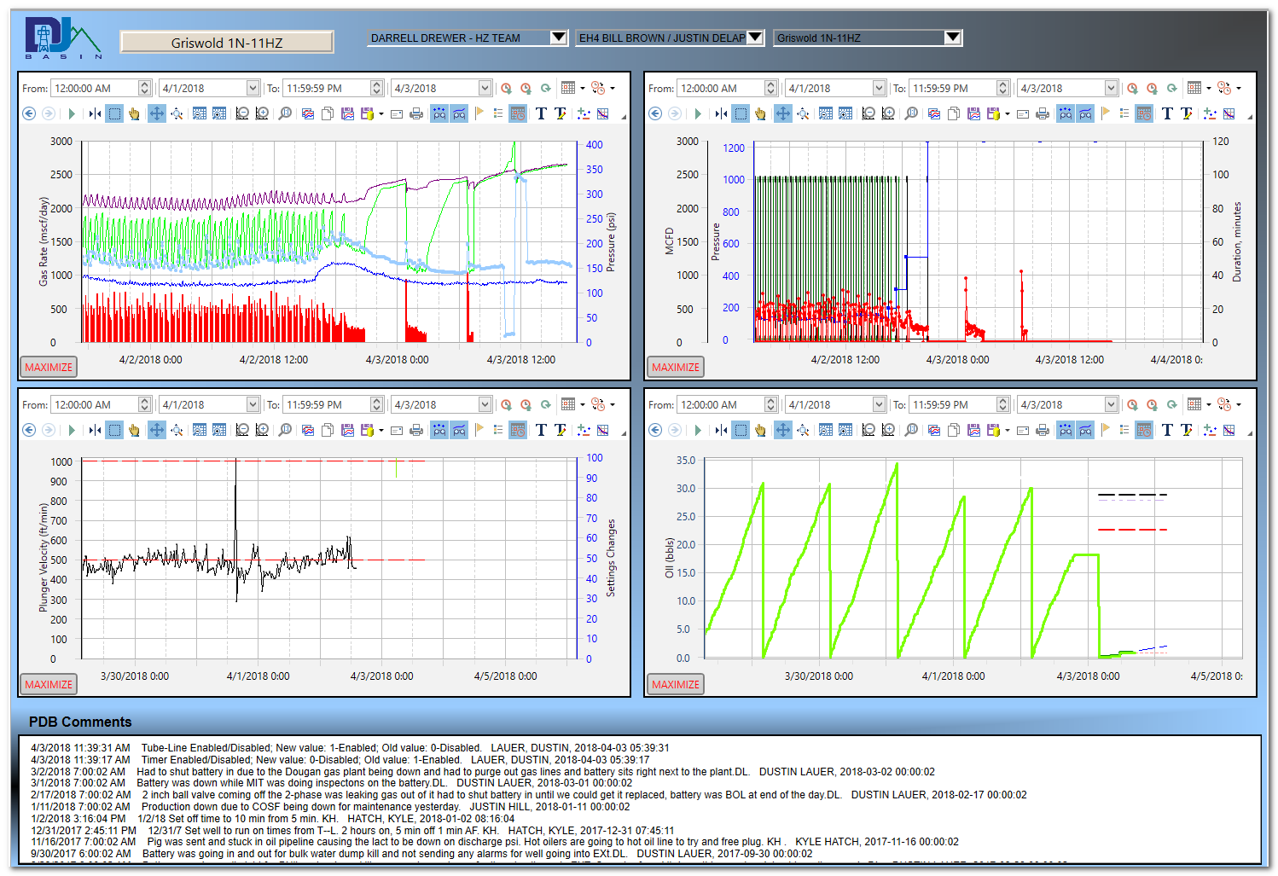
Real-Time Production Tracking
Automated workflow analyzes intraday produced volumes and flags wells that are not on trend to meet the production target and provides information on the root cause of the production shortfall
  This well’s plunger lift was not optimized and eventually loaded up

Slide 19
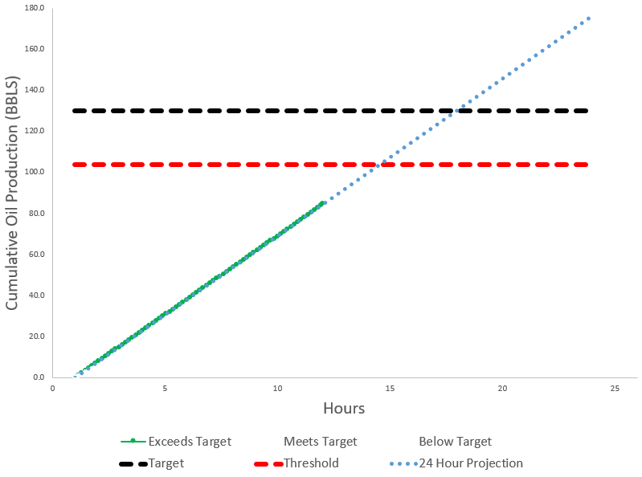
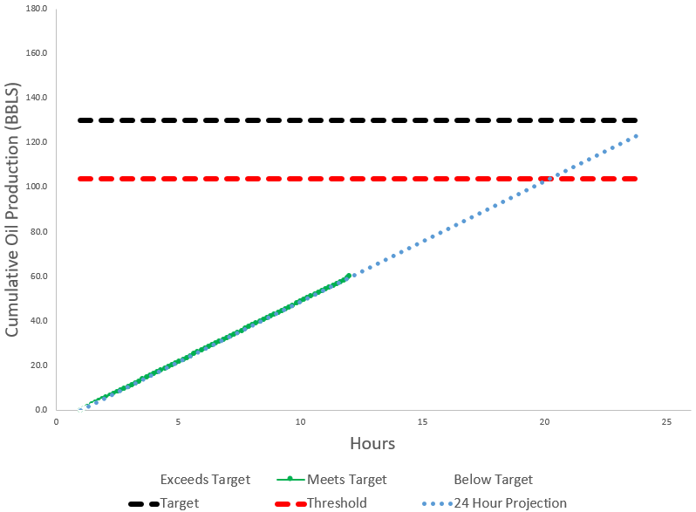
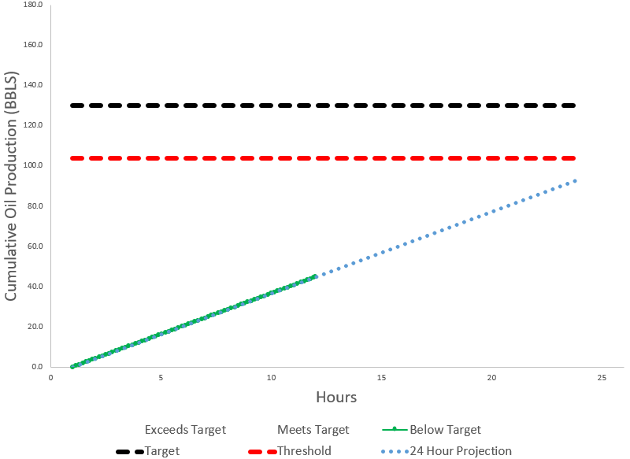
Real Time Production Tracking
Exceeding Target
No attention needed
Meets Target
No attention needed
Below Target
Attention needed
Notes:
Automated workflow analyzes intraday produced volumes and flags wells that are not on trend to meet the production target and provides information on the root cause of the production shortfall
Provides real time field performance insight
Flagging wells that aren’t meeting production target
Whichever is higher between MBX & 30 Day Average
12 hour target calculated every hour
Can slice production delta several different ways
Currently Flagging +/300 wells not meeting target
Some wells may be planned downtime
Working with Ops to track downtime better

Slide 20
Real Time Production Tracker Workflow Process
Comparison Statistics
Workflow duration for 1 Well = +/-0.5 Seconds
  Manual duration for 1 well = +/-30 Minutes
Wells workflow capable of analyzing per day = +/-170k Wells
  Wells manually capable of analyzing per day= +/-50 Wells
Pull last 12 hours of Cumulative Production Data
Data Q/C
Output Data for visualization in graphics
Manual Process
+/-15 Minutes
3
5
1
Manual Process
+/-5 Minutes
Pull last 45 days of Daily Production
Create Target & Projections; Compare against thresholds
Manual Process
+/-3 Minutes
Manual Process
+/-5 minutes
2
4

Slide 21
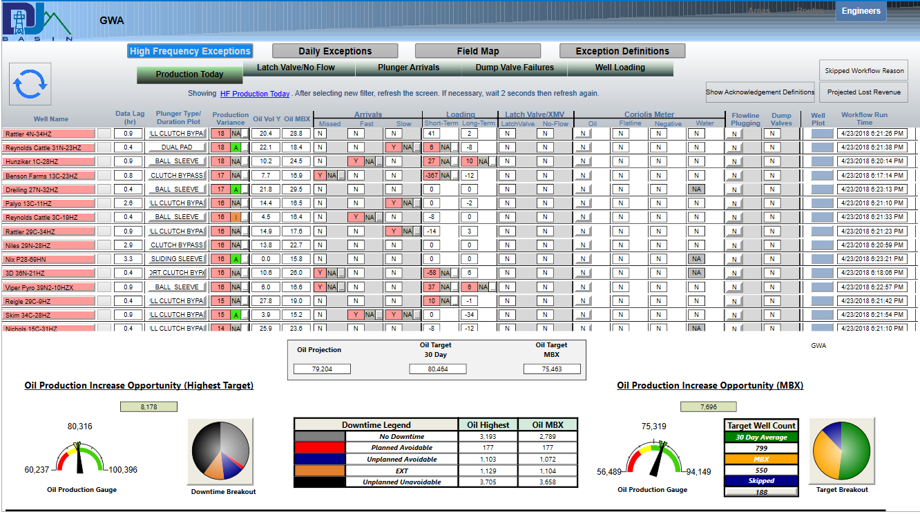
Real Time Production Tracker Summary
Flagged Exceptions
Production Delta
Field Projections & Targets
Visual gauges and Breakouts
PDB Downtime code Production Breakout

Slide 22
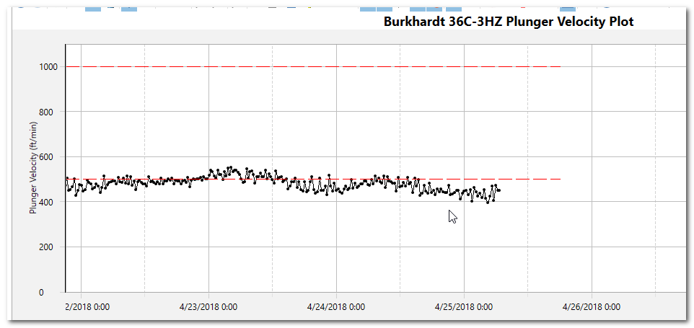
Plunger Arrival Surveillance
Increasing visibility on plunger arrival metrics
  Slow (Below 500 ft/min)
    Adverse production impact. Well could load up
  Fast (Above 1,000 ft/min)
    Shorter equipment lifespan from impact damage to the plunger and lubricator
  Missed (No Arrival)
    Adverse production impact.
  Ability to set Cygnet Settings
Average wells flagged (April): 85
  ~1300 bopd impact
Notes:
Fast Plunger Arrivals: Caused by poor seal from plunger wear or casing build up pressure too high
Quantify value associated with slow / fast or missed plunger arrivals

Slide 23
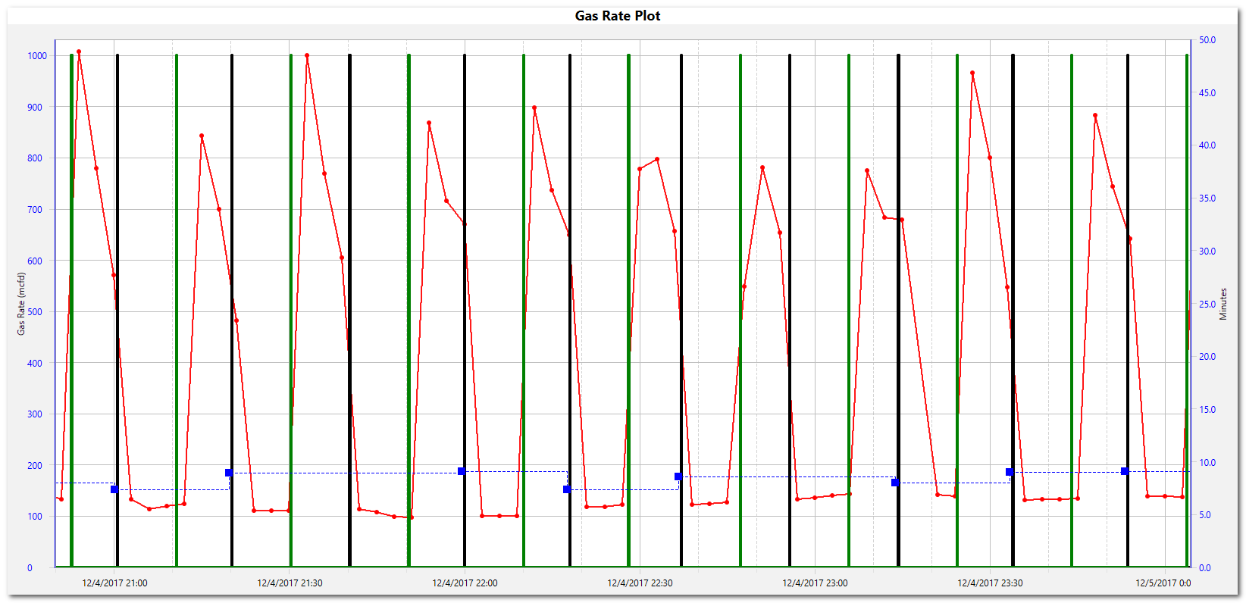
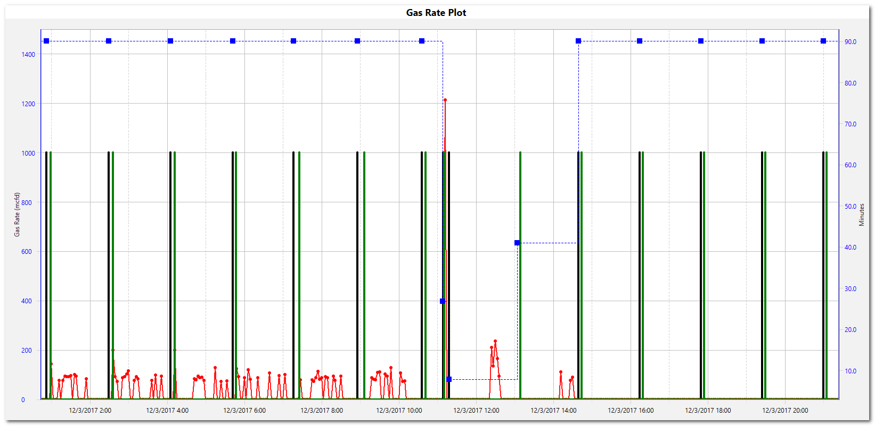
Plunger Motor Valve Surveillance
Plunger motor valve Exception Based Surveillance
Latch Valve
  Flagging gas production during motor valve closures
    Indicates motor valve is potentially stuck open
  Currently Flagging 1-2 wells/day
  ID Tool module built to alert operators in Real Time – waiting on Foremen to push to IOC
No Flow
  Flagging wells with no gas production when motor valve open
    Indicates motor valve is potentially stuck closed
  Currently Flagging 3 Wells

Slide 24
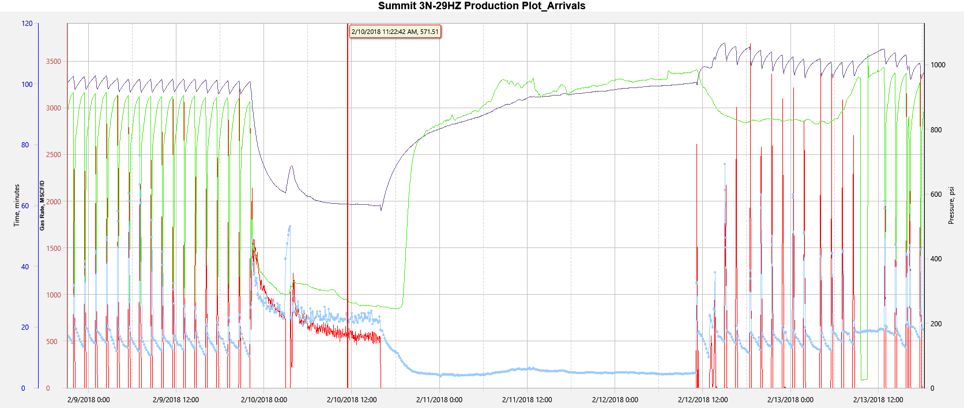
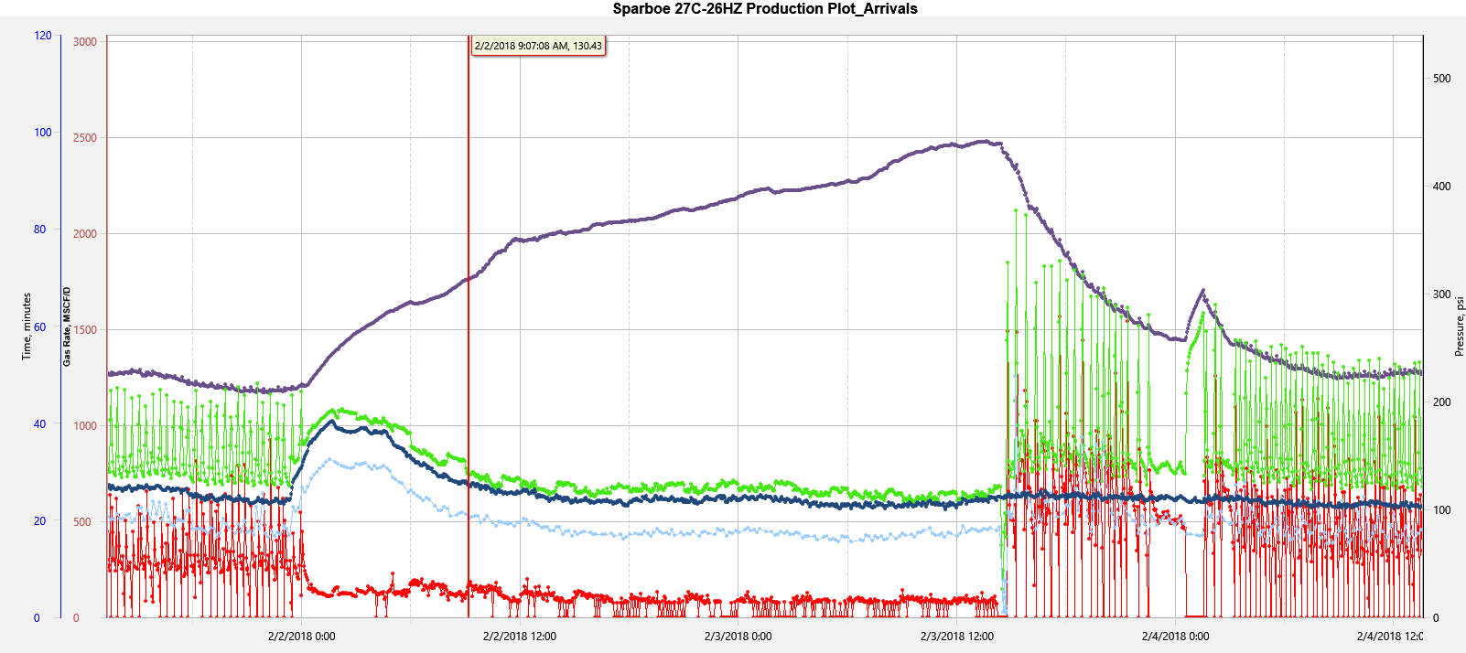
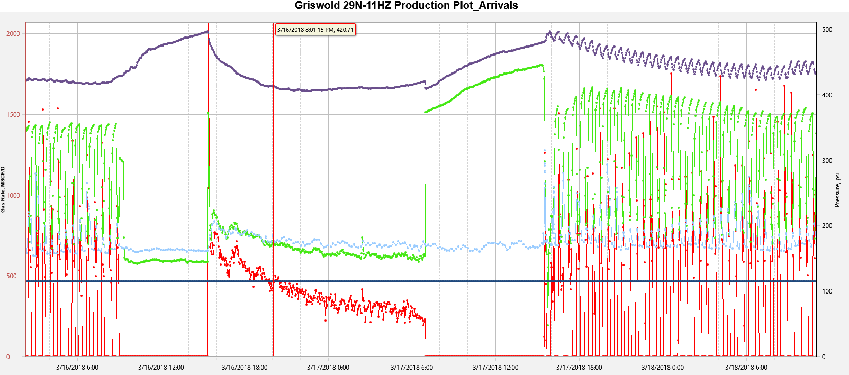
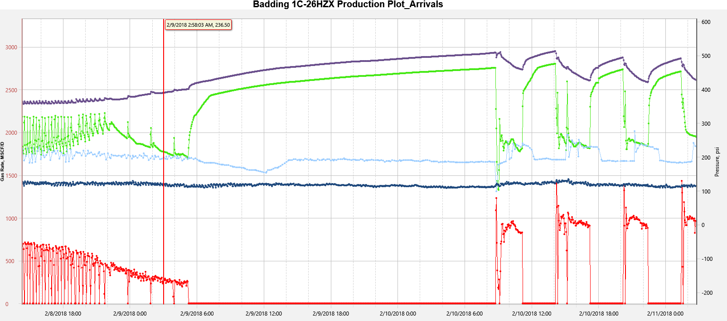
Latch Valve Actionable Examples
Flagged
Caught by IOC
Flagged
Caught by IOC
Flagged
Caught by IOC
Flagged
Caught by IOC

Slide 25
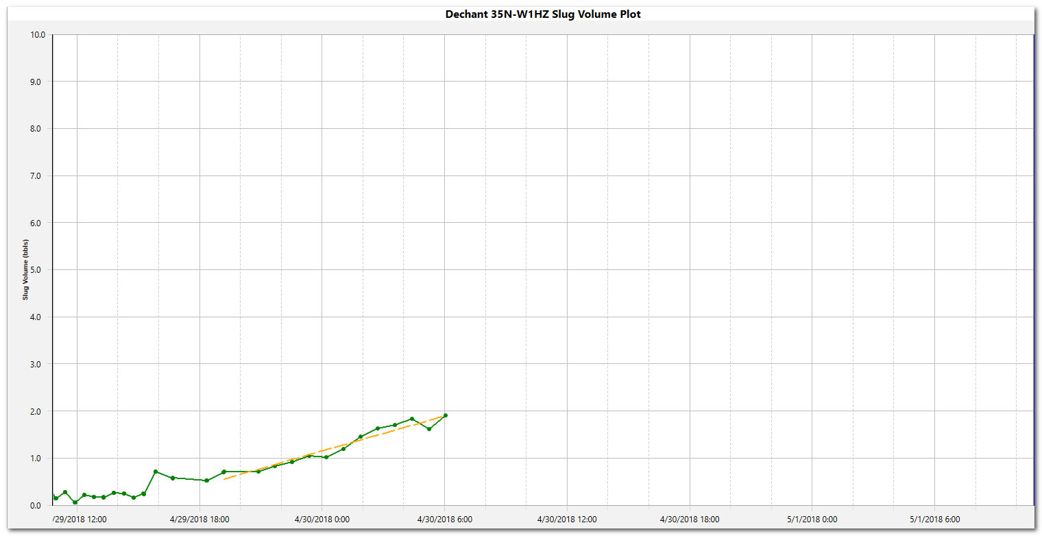
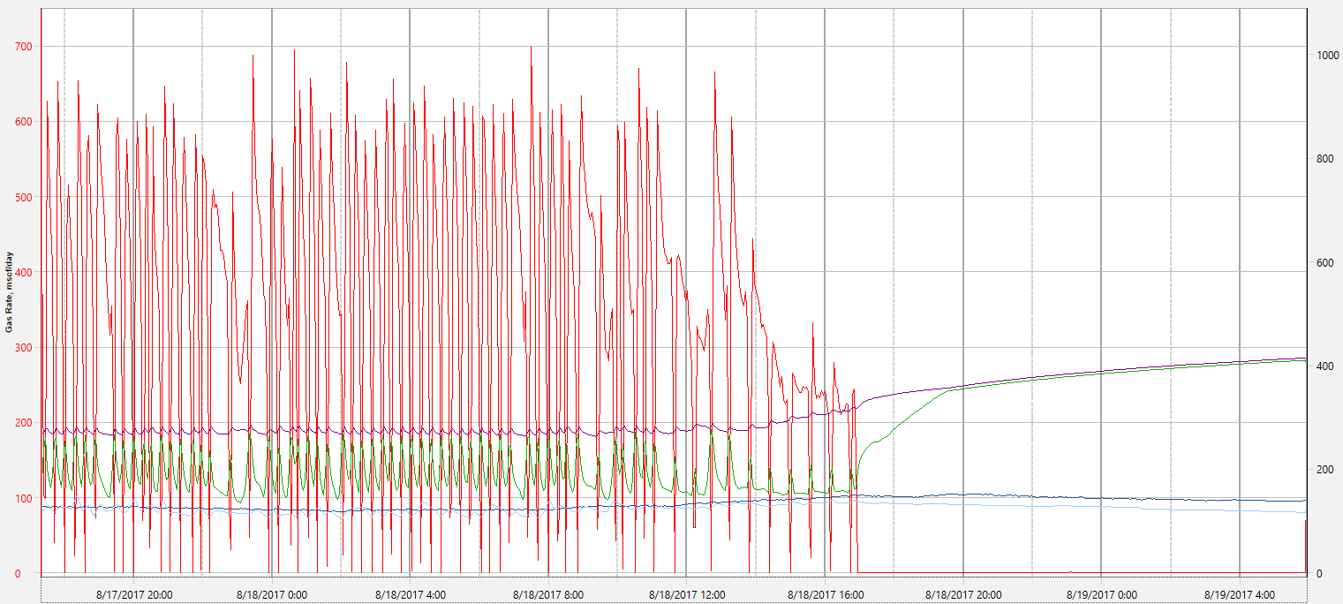
Well Loading
Automated workflow monitors wells for loading
  Casing pressure increasing & tubing pressure decreasing
  Increasing slug volume
Average wells flagged (April): 15
  ~250 bopd impact
Slug Volume Plot
Slug Volume (bbls)
Pressure Rate Plot
Loading Signature
Gas Rate (MCFD)
Casing Pressure (psi)
Pressure (PSI)
Tubing Pressure (psi)
Pressure Differential (psi)
Time
Notes:
No packers so BHP increase is monitored with casing pressure
Slug Volume Increasing at rate of 3 bpd
Positive casing slope over 6 psi/day and negative tubing slope
First Threshold: Line and casing pressure delta over 10 psi / day
Second Threshold: Less than 0 trips in the last 12 hrs
How is the slug volume calculated?

Slide 26
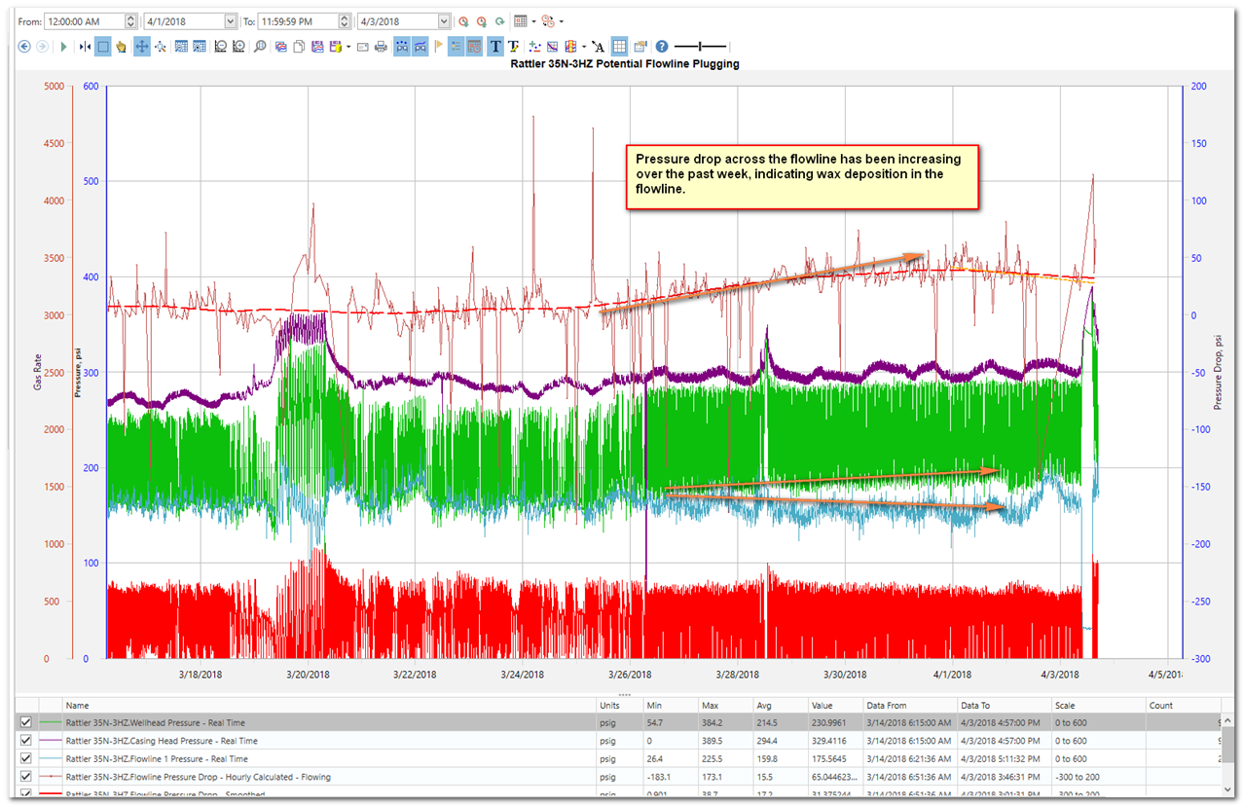
Flowline Plugging
Flowline Plugging
  Enabled by data science implementation with ready access to raw data
    Automated proactive flagging
  Prevented ~3800 bbls of downtime in September 2017
  Rate of complete flowline plugging reduced
    ~8 wells plugged/month (June-September) reduced to 2 (November 2017)

Slide 27
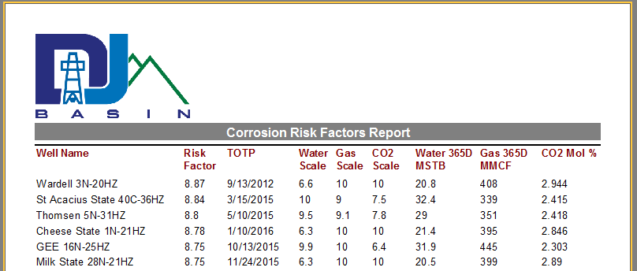
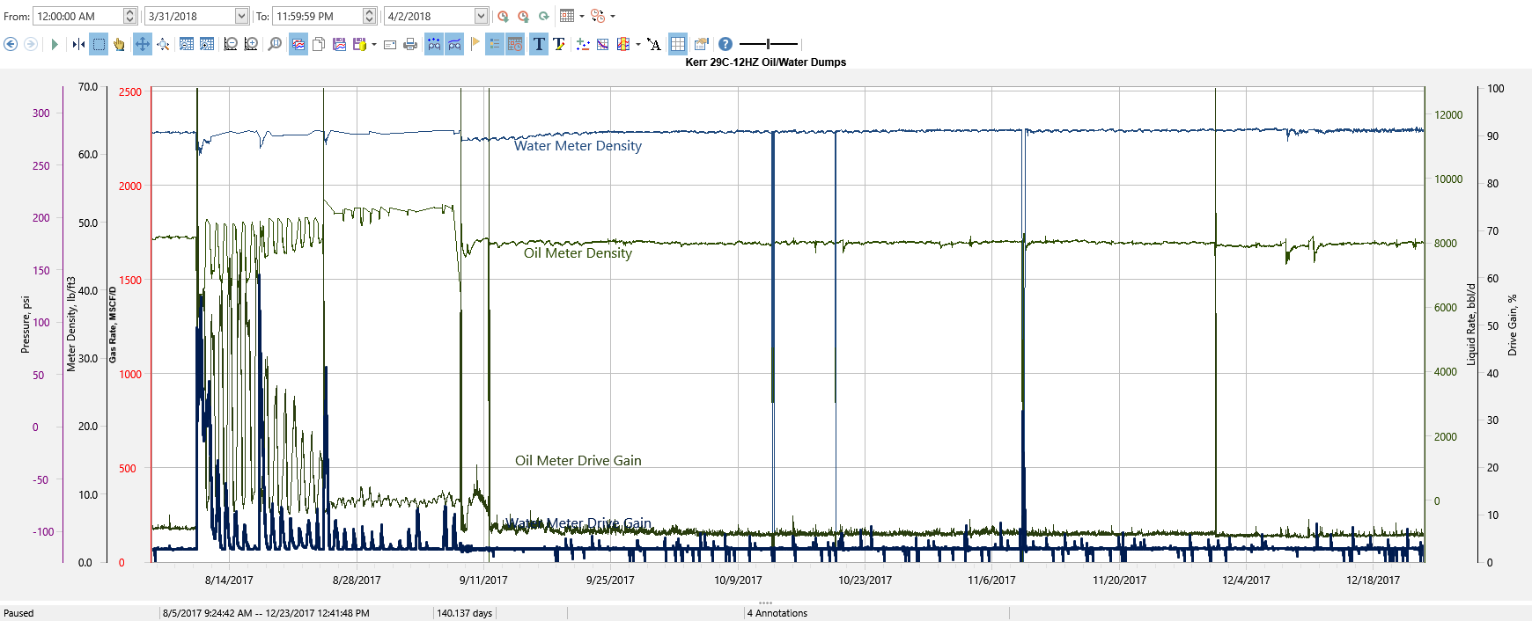
Flow Assurance
Corrosion Risk Factors Study
  Report generated in IVM to rank all HZ wells according to Corrosion Risk
  Used to prioritize wells for tubing integrity logging
Loss of primary containment investigation
  Ex. Looking for historical events of gas blow-by on the water leg of a production separator which could introduce corrosive amounts of CO2 to that part of the system

Slide 28
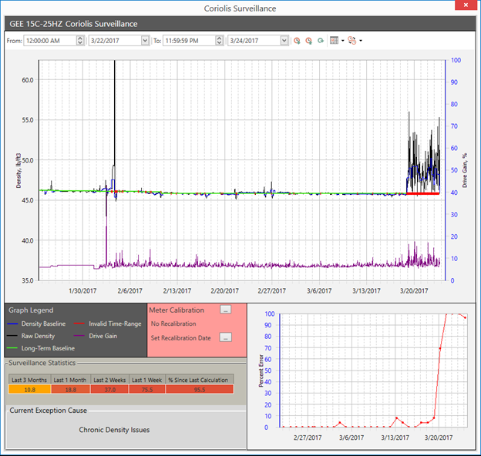
Coriolis Meter Surveillance
An automated workflow monitors density (black line) and drive gain (purple line) readings from all HZ well oil meters and can identify erroneous operations
  This event was confirmed to be a gas blow-by issue after it was flagged to the engineer

Slide 29
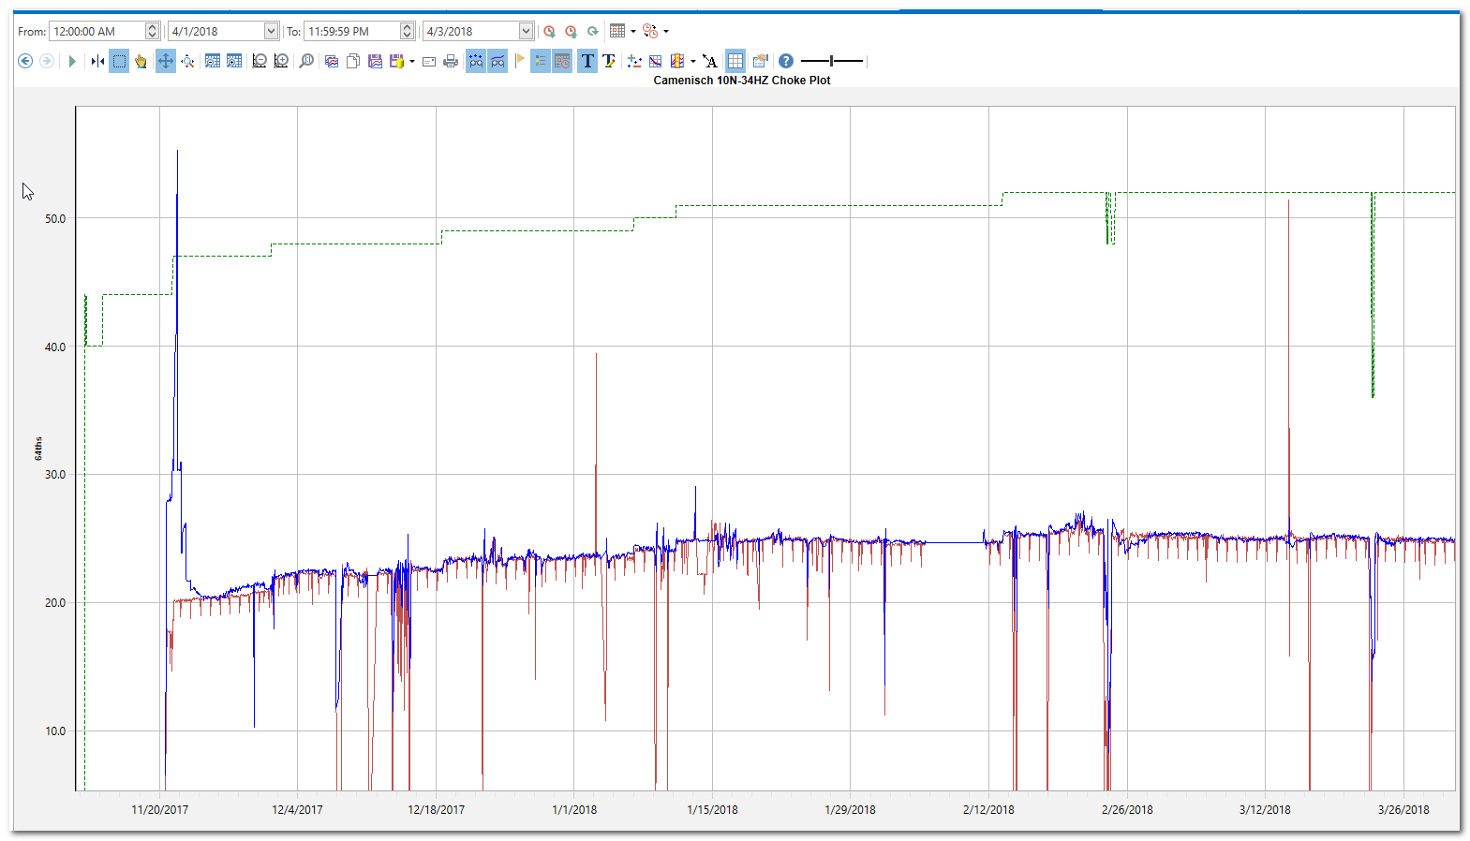
Choke Management
Real time production data is utilized to calculate an equivalent choke size on every HZ well that has an “autochoke”
  Enables engineers to ensure proper drawdown strategy is being applied to each well
  Can also identify chokes that are washing out, plugging off, or that need to be recalibrated
Notes:
Automated workflow provided guidance on choke management. One step every two weeks after POL. Then 90 days after. Reviews RPI plot following choke bumps

Slide 30
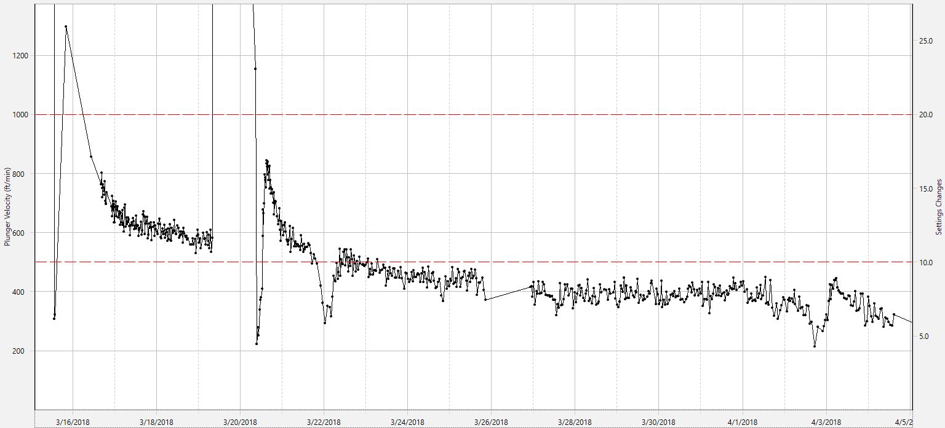
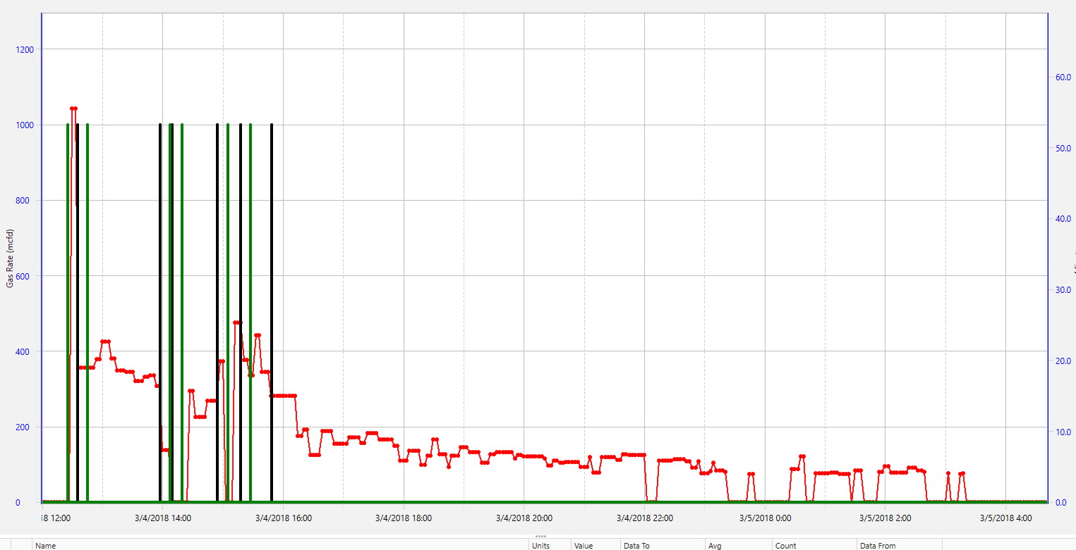
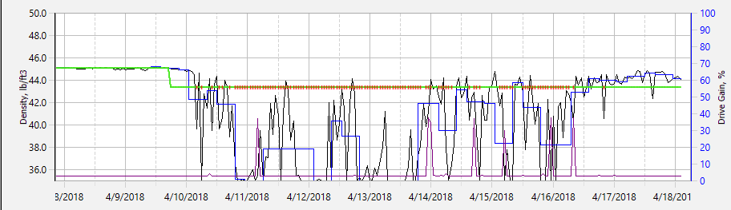
Exception Based Workflows (Summary)
Downhole Exceptions
  Artificial Lift Optimization
  Well Loading
  Well No Flow
Equipment Failure Exceptions
  Motor Valve Failure
  Flowline Plugging
Measurement Exceptions
  Meter Failure

Slide 31
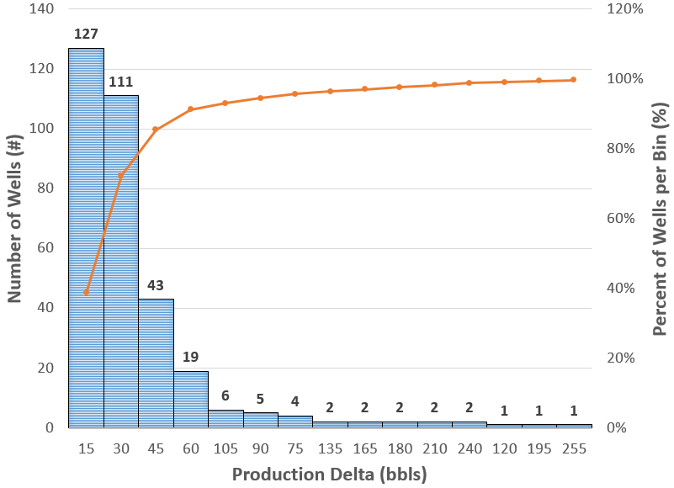
Production Opportunity Statistics
Very few single large wins
  +/-85% range from 5 bbls to 50 bbls
Total in that Range = +/-5,500 bbls
Small increments add up!
Notes:
Sum the first 2 buckets

Slide 32
Results & Value
Analyzes 1,500+ wells per hour
Prioritizes wells that need attention
Highlights issues with wells with graphics
Average of +/-250 of +/-1,500 wells flagged from Production Tracker Workflow at all times
7 primary Exception Based Workflows running every hour
Graphic summary breakouts of field production
Target value for DJ Basin:
Breakout Type | Average Production Opportunity | Avg. Deferred Revenue per Day ($60/bbl) | Extrapolated Deferred Revenue per Year
All Wells | 8,000 bbls | $480k | $175MM
Wells Flagging w/ Exceptions | 6,000 bbls | $360k | $130MM
Wells w/o PDB Downtime Codes | 3,500 bbls | $210k | $75MM
Notes:
Production Tracker flagged exceptions $60/bbl Gross

